Slide 1
ACUTE AND CHRONIC PANCREATITIS

Slide 2
ACUTE PANCREATITIS
Acute pancreatitis accounts for 3% of all cases of abdominal pain admitted to hospital.
It is a potentially serious condition with an overall mortality of 10%
About 80% of all cases are mild and have a favourable outcome
Approximately 98% of deaths from pancreatitis occur in the 20% of patients with severe disease and about one-third of these arise within the first week, usually from multi-organ failure.
Acute pancreatitis occurs as a consequence of premature intracellular trypsinogen activation, releasing proteases that digest the pancreas and surrounding tissue. Triggers for this are many, including alcohol, gallstones and pancreatic duct obstruction.

Slide 3
After the 1st week, the majority of deaths result from sepsis, especially that complicating infected necrosis. At admission, it is possible to predict patients at risk of these complications.

Slide 4
Assessment of the severity of AP
There are different scoring systems had been created to predict the severity of AP that include :
Glasgow criteria
APACHE II score
Ranson’s score
BISAP score

Slide 5
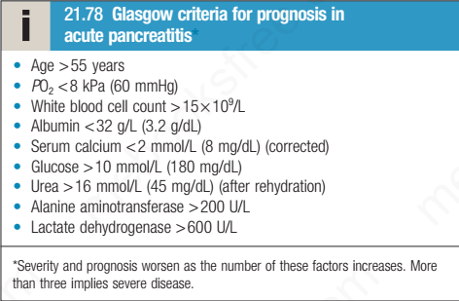

Slide 6
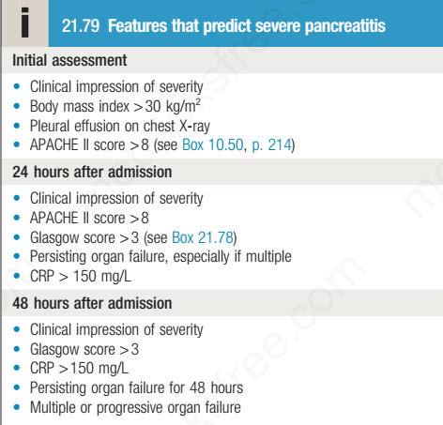

Slide 7
BISAP score involve the following:
B.urea >25mg/dl
Impaired sensorium
Systemic inflammatory syndrome
Age>60
Pleural effusion
One point is given for each one, severe pancreatitis =>3 points

Slide 8
Clinical features
severe, constant upper abdominal pain, of increasing intensity over 15–60 minutes, which radiates to the back.
Nausea and vomiting
There is marked epigastric tenderness, but in the early stages (and in contrast to a perforated peptic ulcer), guarding and rebound tenderness are absent because the inflammation is principally retroperitoneal
Bowel sounds become quiet or absent as paralytic ileus develops.

Slide 9
In severe cases, the patient becomes hypoxic and develops hypovolaemic shock with oliguria.
Discoloration of the flanks (Grey Turner’s sign) or the periumbilical region (Cullen’s sign) is a feature of severe pancreatitis with haemorrhage.

Slide 10
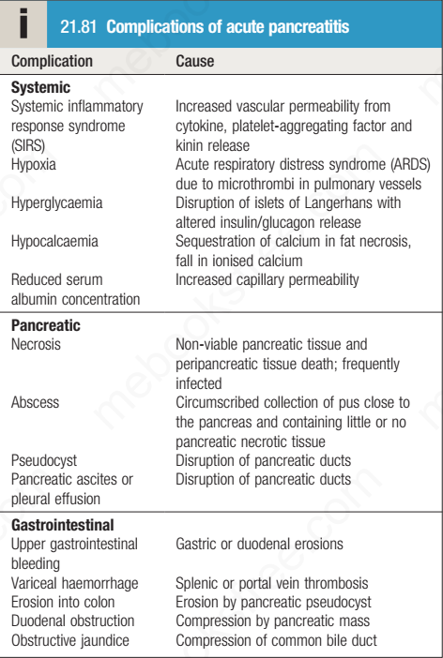

Slide 11
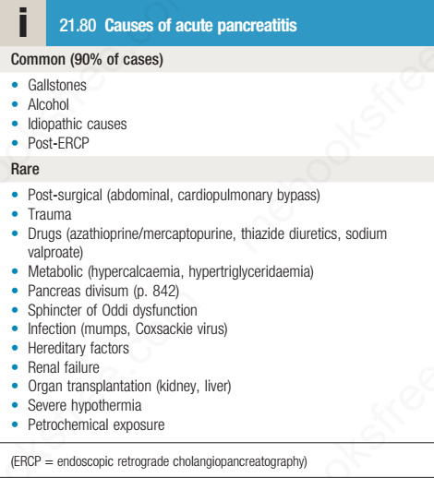

Slide 12
Investigations:
The diagnosis is based on raised serum amylase or lipase concentrations and ultrasound or CT evidence of pancreatic swelling
Plain X-rays should be taken to exclude other diagnoses, such as perforation or obstruction, and to identify pulmonary complications.
Certain investigations stratify the severity of acute pancreatitis and have important prognostic value at the time of presentation.

Slide 13
Management
Management comprises several related steps:
• establishing the diagnosis and disease severity
• early resuscitation, according to whether the disease is mild or severe
• detection and treatment of complications
• treatment of the underlying cause

Slide 14
Opiate analgesics should be given to treat pain
hypovolaemia should be corrected using normal saline or other crystalloids
All severe cases should be managed in a high-dependency or intensive care unit
A central venous line and urinary catheter should be inserted to monitor patients with shock.
Oxygen should be given to hypoxic patients, and those who develop systemic inflammatory response syndrome (SIRS) may require ventilatory support.

Slide 15
Hyperglycaemia should be corrected using insulin and hypocalcaemia by intravenous calcium injection.
Nasogastric aspiration is required only if paralytic ileus is present
Enteral feeding, if tolerated, should be started at an early stage in patients with severe pancreatitis because they are in a severely catabolic state and need nutritional support.
Nasogastric feeding is just as effective as feeding by the nasojejunal route
Prophylaxis of thromboembolism with subcutaneous low-molecular-weight heparin is also advisable
The use of prophylactic, broad-spectrum intravenous antibiotics to prevent infection of pancreatic necrosis is not indicated, but infected necrosis is treated with antibiotics that penetrate necrotic tissue, e.g. carbapenems or quinolones, and metronidazole

Slide 16
Patients who present with cholangitis or jaundice in association with severe acute pancreatitis should undergo urgent ERCP to diagnose and treat choledocholithiasis
Patients with infected pancreatic necrosis or pancreatic abscess require urgent endoscopic drainage or minimally invasive retroperitoneal pancreatic (MIRP) necrosectomy to debride all cavities of necrotic material
Pancreatic pseudocysts can be treated by drainage into the stomach or duodenum. This is usually performed after an interval of at least 6 weeks, once a pseudocapsule has matured, by surgical or endoscopic cystogastrostomy

Slide 17
Pancreatic fluid collection in AP :
ACUTE PERIPANCREATIC FLUID COLLECTION:
HOMOGENOUS (NO DEBRIS), <4 WEEKS FROM ONSET OF AP
2. PANCREATIC PSEUDOCYSTE
HOMOGENOUS,MATURE SURRONDING CAPSULE , >4 WEEKS
3. ACUTE PANCREATIC NECROSIS :
CONTAIN DEBRIS, STERILE OR INFECTED,<4WEEKS
4. WALLED OFF NECROSIS
CONTAIN DEBRIS,MATUTRE CAPSULE,>4WEEKS

Slide 18
pseudocysts’ are common and usually asymptomatic, resolving as the pancreatitis recovers.
Pseudocysts greater than 6 cm in diameter seldom disappear spontaneously and can cause constant abdominal pain and compress or erode surrounding structures, including blood vessels, to form pseudoaneurysms.
Large pseudocysts can be detected clinically as a palpable abdominal mass.
Pancreatic ascites occurs when fluid leaks from a disrupted pancreatic duct into the peritoneal cavity. Leakage into the thoracic cavity can result in a pleural effusion or a pleuro-pancreatic fistula

Slide 19
Chronic pancreatitis:
Chronic pancreatitis is a chronic inflammatory disease characterised by fibrosis and destruction of exocrine pancreatic tissue. Diabetes mellitus occurs in advanced cases because the islets of Langerhans are involved.

Slide 20
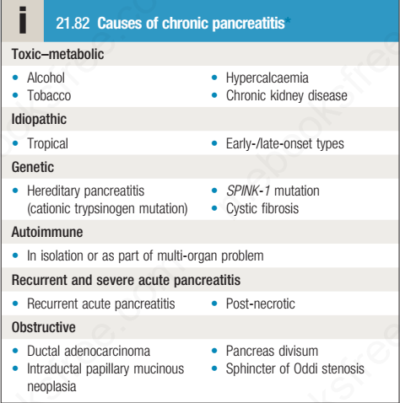

Slide 21
Clinical features
abdominal pain. Pain is due to a combination of increased pressure within the pancreatic ducts and direct involvement of peripancreatic nerves by the inflammatory process.
Pain may be relieved by leaning forwards or by drinking alcohol
Diarrhoea :Steatorrhoea occurs when more than 90% of the exocrine tissue has been destroyed; protein malabsorption develops only in the most advanced cases

Slide 22
Overall, 30% of patients have (secondary) diabetes but this figure rises to 70% in those with chronic calcific pancreatitis.
Weight loss is common and results from a combination of anorexia, avoidance of food because of post-prandial pain, malabsorption and/or diabetes
Physical examination reveals a thin, malnourished patient with epigastric tenderness. Skin pigmentation over the abdomen and back is common and results from chronic use of a hot water bottle (erythema ab igne)

Slide 24
Investigations in chronic pancreatitis
Tests to establish the diagnosis
• Ultrasound
• Computed tomography (may show atrophy, calcification or ductal
dilatation)
• Abdominal X-ray (may show calcification)
• Magnetic resonance cholangiopancreatography
• Endoscopic ultrasound
Tests to define pancreatic function
• Collection of pure pancreatic juice after secretin injection (gold
standard but invasive and seldom used)
• Pancreolauryl test
• Faecal pancreatic elastase
Tests to demonstrate anatomy prior to surgery
• Magnetic resonance cholangiopancreatography

Slide 25
Management
Alcohol avoidance
Pain relief : NSAIDs, Analgesics, such as pregabalin and tricyclic antidepressants at a low dose, may be effective.
Oral pancreatic enzyme supplements suppress pancreatic secretion and their regular use reduces analgesic consumption in some patients
Coeliac plexus neurolysis sometimes produces long-lasting pain relief

Slide 26
Malabsorption:
Fat restriction (with supplementary medium-chain triglyceride therapy in malnourished patients
oral pancreatic enzyme supplements
A PPI is added to optimize duodenal pH for pancreatic enzyme activity
Management of complications:
Surgical or endoscopic therapy may be necessary for the management of pseudocysts, pancreatic ascites, common bile duct or duodenal stricture and the consequences of portal hypertension.

Slide 27
Autoimmune pancreatitis
Autoimmune pancreatitis (AIP) is a form of chronic pancreatitis that can mimic cancer but which responds to glucocorticoids
It is characterised by abdominal pain, weight loss or obstructive jaundice, without acute attacks of pancreatitis
Blood tests reveal increased serum IgG or IgG4 and the presence of other autoantibodies
Imaging shows a diffusely enlarged pancreas, narrowing of the pancreatic duct and stricturing of the lower bile duct.

Slide 28
AIP may occur alone or with other autoimmune disorders, such as Sjögren’s syndrome, primary sclerosing cholangitis or IBD. The response to glucocorticoids is usually excellent but some patients require Azathioprine.
It is of two types : type I AIP AND TypeII AIP

Slide 29
THANKS

